Slide 1
Astro 331 Lesson 10
Payloads & Spacecraft Budgets
SMAD Ch 9.3-9.5, 10.3

Slide 2
Lesson Objectives
Select payload frequencies using Wein’s Law and atmospheric windows
Determine whether an optical payload’s resolution is diffraction limited or pixel limited
List and describe the four common observation payload types
Describe the four dimensions for characterizing remote sensing information (spatial, spectral, radiometric, temporal)
Calculate the approximate data rate for payload data
Understand and apply the different types of design budgets used during the preliminary design of a spacecraft

Slide 3
Overview of Electromagnetic Spectrum

Slide 4
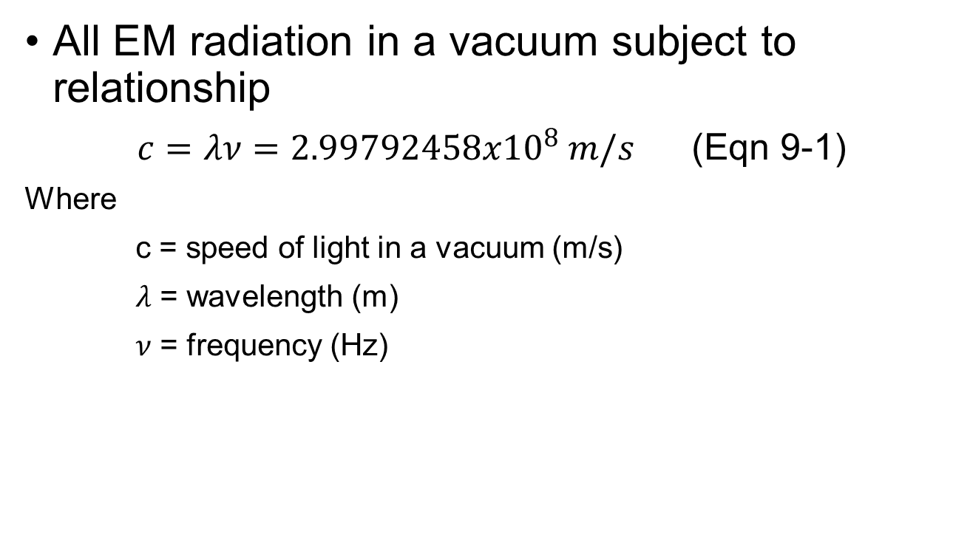
Electromagnetic Spectrum
All EM radiation in a vacuum subject to relationship
$c=λν=2.99792458x{10}^{8} m/s$ (Eqn 9-1)
Where
c = speed of light in a vacuum (m/s)
$λ$ = wavelength (m)
$ν$ = frequency (Hz)

Slide 5
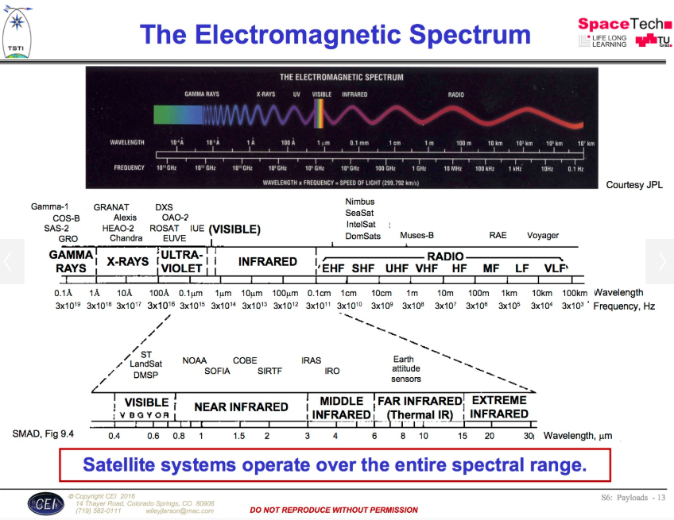
Designing Space Missions and Systems, Presentation Slide S6: Payloads - 13

Slide 6
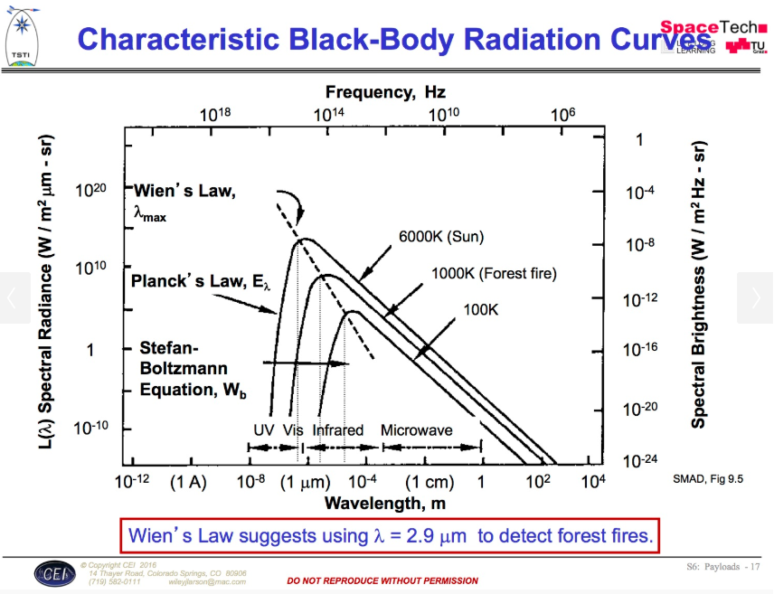
Designing Space Missions and Systems, Presentation Slide S6: Payloads - 17

Slide 7
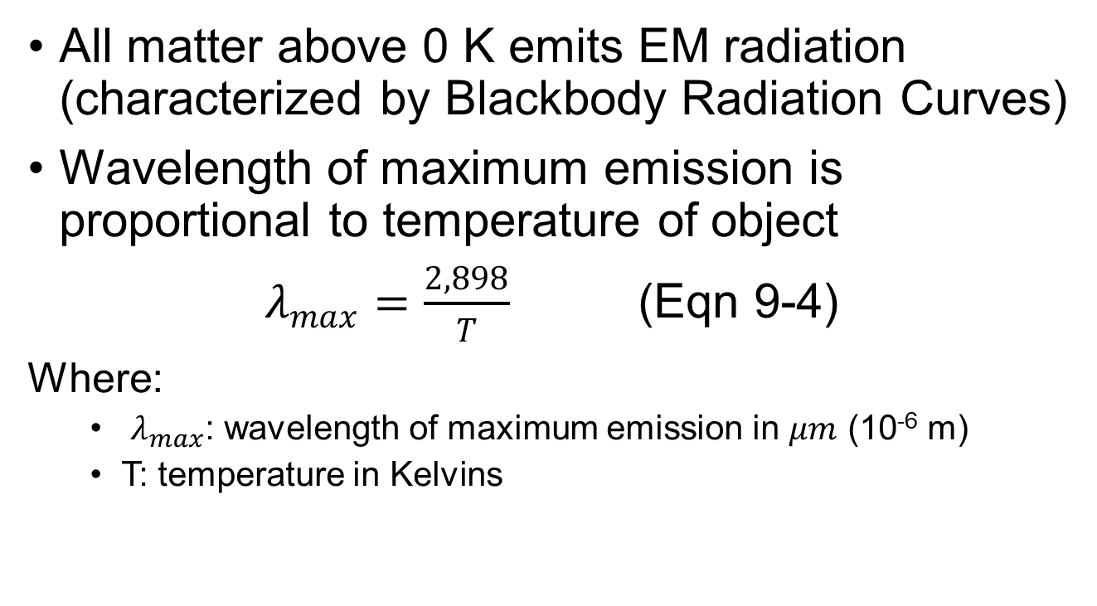
Wien’s Law
All matter above 0 K emits EM radiation (characterized by Blackbody Radiation Curves)
Wavelength of maximum emission is proportional to temperature of object
$λ_{max}=\frac{2,898}{T}$ (Eqn 9-4)
Where:
$λ_{max}$: wavelength of maximum emission in $μm$ (10⁻⁶ m)
T: temperature in Kelvins

Slide 8
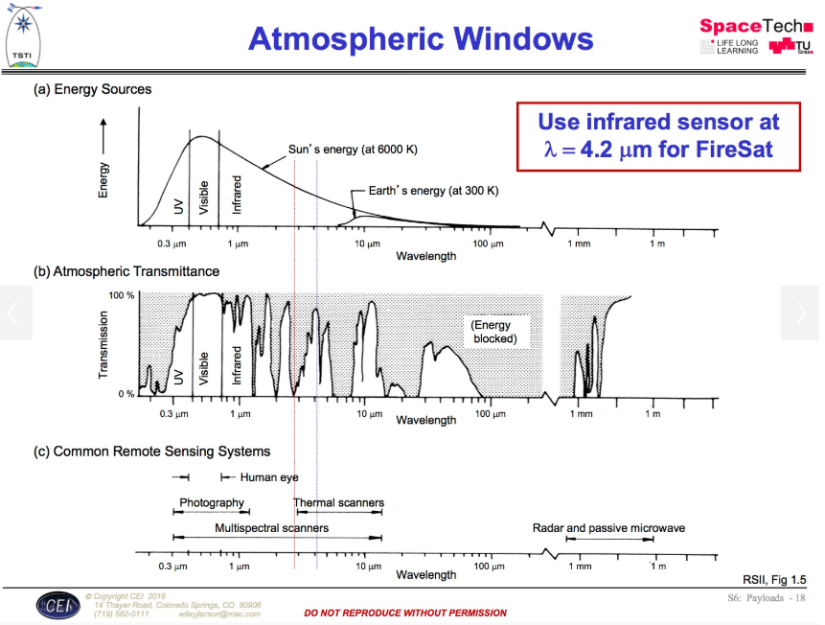
Designing Space Missions and Systems, Presentation Slide S6: Payloads - 18

Slide 9
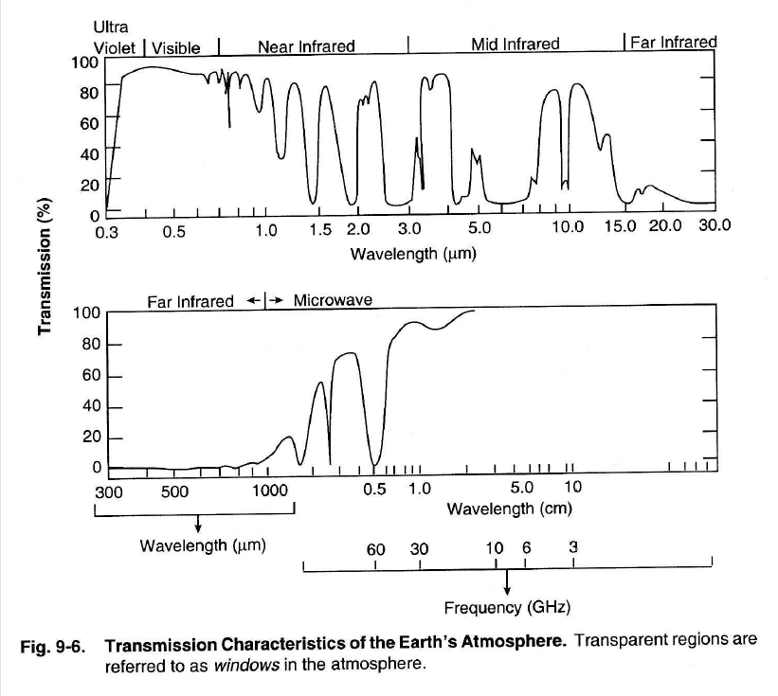

Slide 10
Telescope Design & Resolution

Slide 11
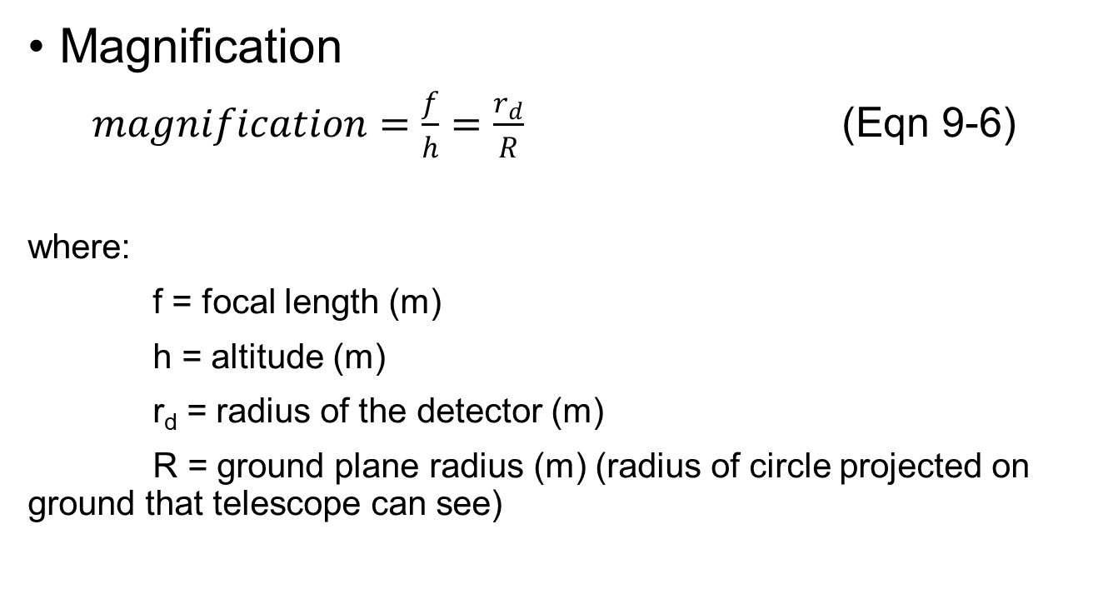
Basic Telescope Optics (1/2)
Magnification
$magnification=\frac{f}{h}=\frac{r_{d}}{R}$ (Eqn 9-6)
where:
f = focal length (m)
h = altitude (m)
r_{d} = radius of the detector (m)
R = ground plane radius (m) (radius of circle projected on ground that telescope can see)

Slide 12
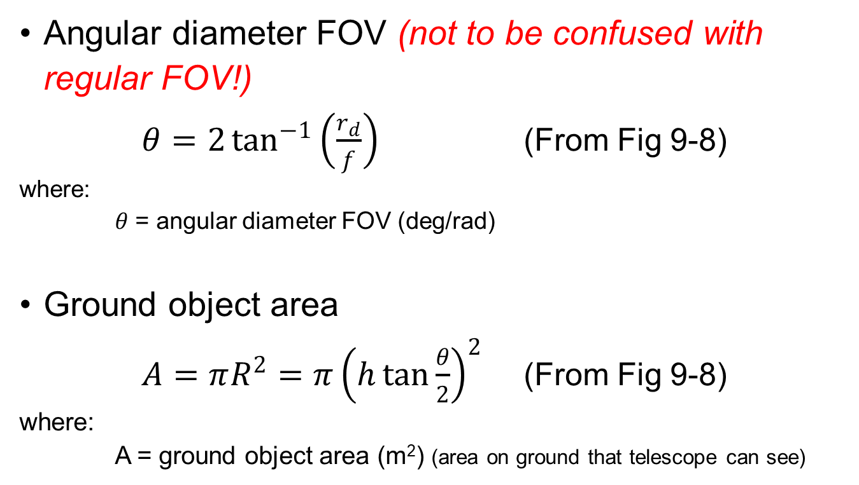
Basic Telescope Optics (2/2)
Angular diameter FOV (not to be confused with regular FOV!)
$θ=2\tan^{−1}\left(\frac{r_{d}}{f}\right)$ (From Fig 9-8)
where:
$θ$ = angular diameter FOV (deg/rad)
Ground object area
$A=πR^{2}=π{\left(h\tan{\frac{θ}{2}}\right)}^{2}$ (From Fig 9-8)
where:
A = ground object area (m²) (area on ground that telescope can see)

Slide 13
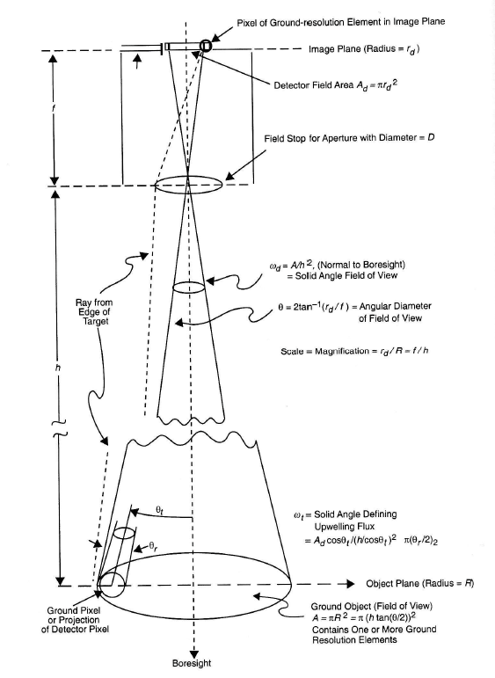


Slide 14
Resolution
Resolution: separation distance (or angle) to distinguish between two identical objects
To avoid confusion, refer to resolution as improving or better rather than increasing or decreasing
a smaller numerical value is better than a larger numerical value

Slide 15
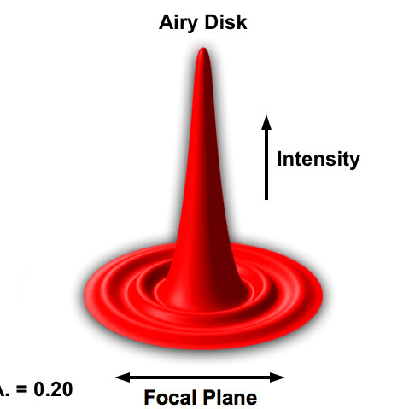
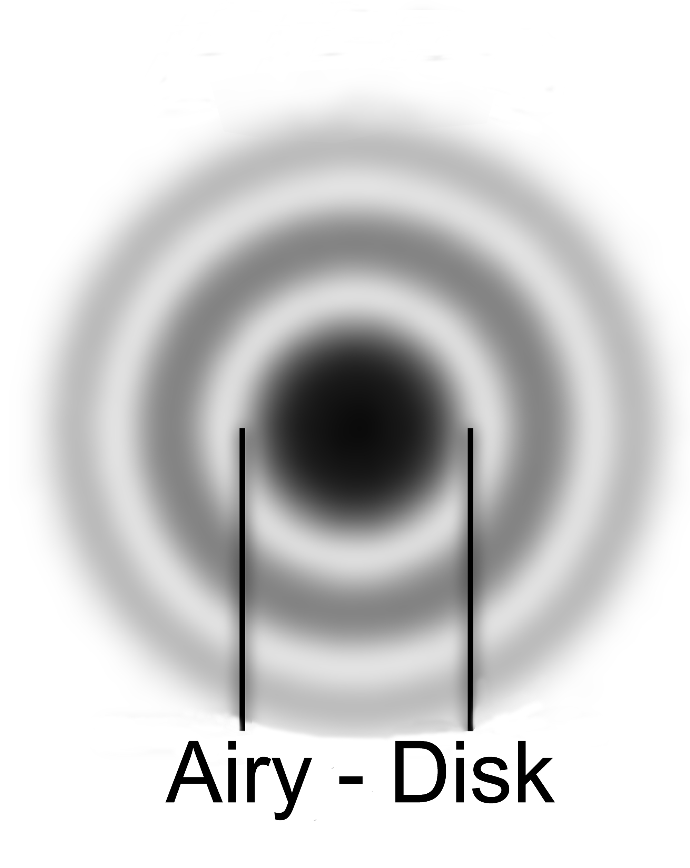
Diffraction Limited Resolution (1/4)
Diffraction limited resolution is caused by light bending at the edge of the optical system
a point source will appear to be disk with concentric rings of decreasing intensity
https://www.microscopyu.com/tutorials/imageformation-airyna
http://www.jb.man.ac.uk/public/im/clearly.html

Slide 16
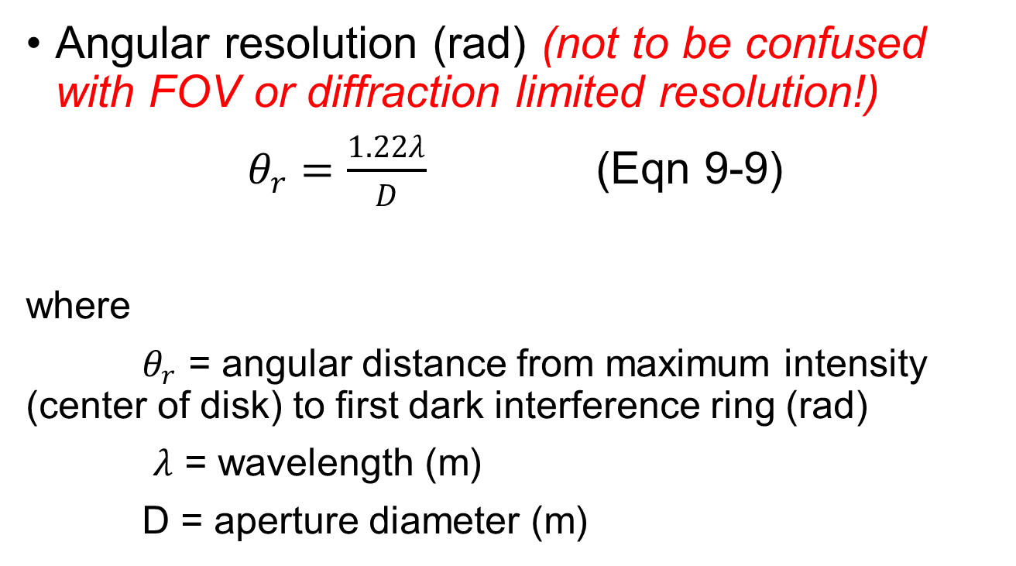
Diffraction Limited Resolution (2/4)
Angular resolution (rad) (not to be confused with FOV or diffraction limited resolution!)
$θ_{r}=\frac{1.22λ}{D}$ (Eqn 9-9)
where
$θ_{r}$ = angular distance from maximum intensity (center of disk) to first dark interference ring (rad)
$λ$ = wavelength (m)
D = aperture diameter (m)

Slide 17
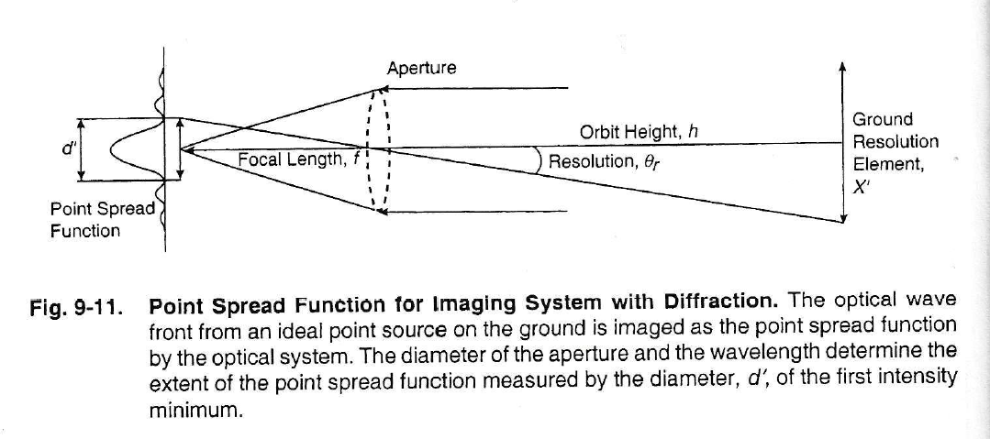
Diffraction Limited Resolution (3/4)

Slide 18
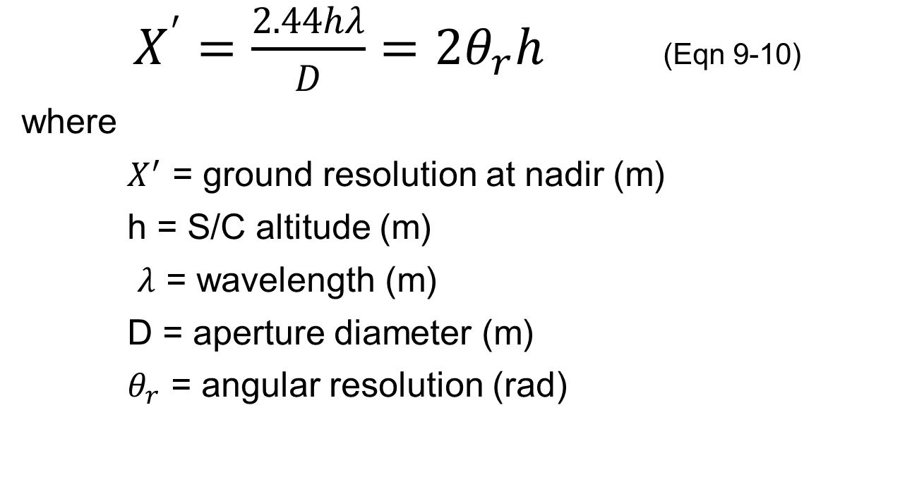
Diffraction Limited Resolution (4/4)
$X^{′}=\frac{2.44hλ}{D}=2θ_{r}h$ (Eqn 9-10)
where
$X^{′}$ = ground resolution at nadir (m)
h = S/C altitude (m)
$λ$ = wavelength (m)
D = aperture diameter (m)
$θ_{r}$ = angular resolution (rad)

Slide 19
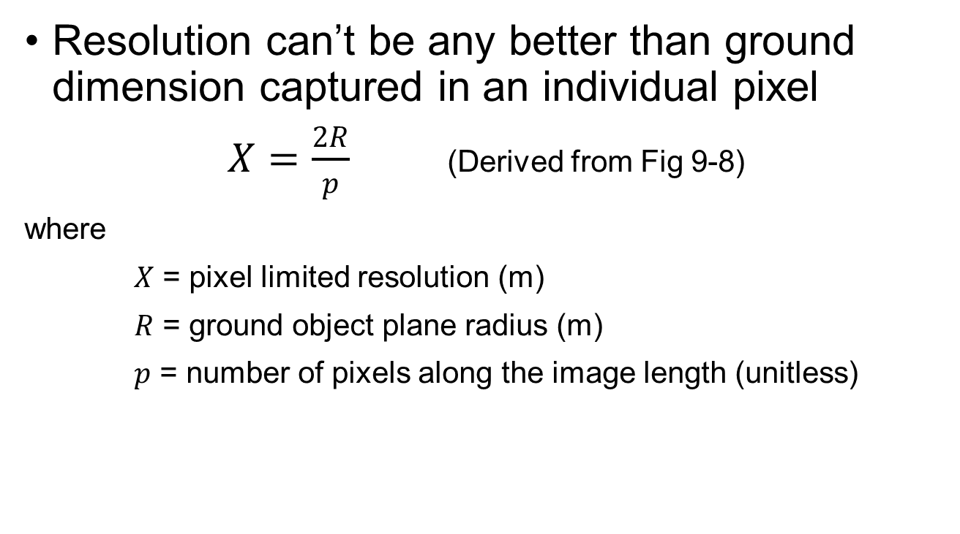
Pixel Limited Resolution
Resolution can’t be any better than ground dimension captured in an individual pixel
$X=\frac{2R}{p}$ (Derived from Fig 9-8)
where
$X$ = pixel limited resolution (m)
$R$ = ground object plane radius (m)
$p$ = number of pixels along the image length (unitless)

Slide 20
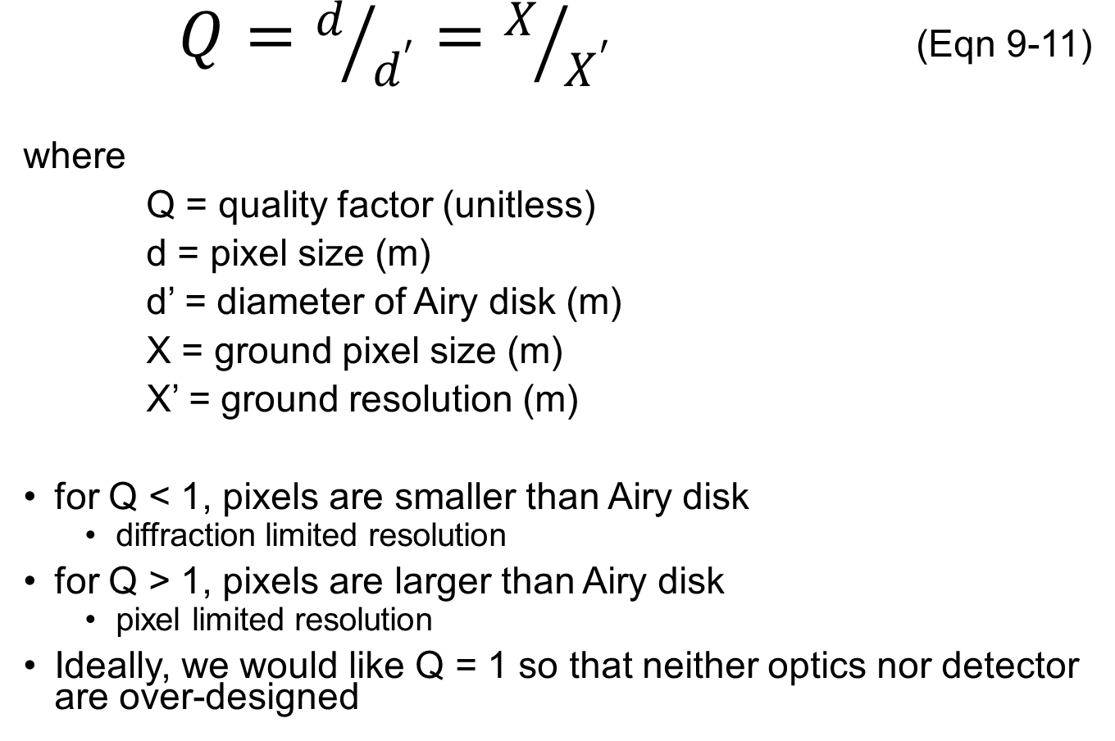
Quality Factor (1/2)
$Q=d/{d^{′}}=X/{X^{′}}$ (Eqn 9-11)
where
Q = quality factor (unitless)
d = pixel size (m)
d’ = diameter of Airy disk (m)
X = ground pixel size (m)
X’ = ground resolution (m)
for Q < 1, pixels are smaller than Airy disk
diffraction limited resolution
for Q > 1, pixels are larger than Airy disk
pixel limited resolution
Ideally, we would like Q = 1 so that neither optics nor detector are over-designed

Slide 21
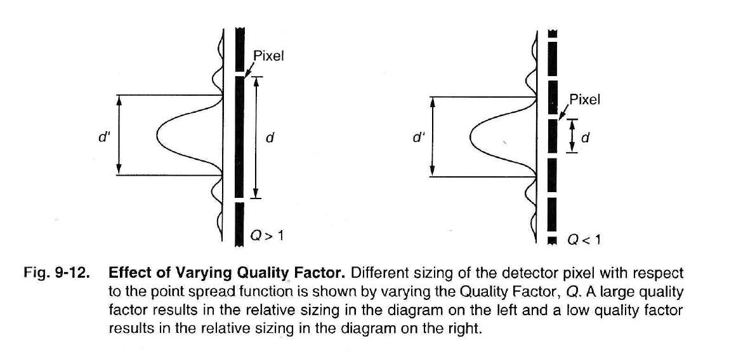
Quality Factor (2/2)

Slide 22
Projection of Ground Resolution Element in Image Plane
(width = d)
Image Plane
(radius = r_{d})
Focal Length, f
Lens Aperture
(diameter = D)
Altitude, h
FOV
θ_{r}
Ground Pixel or
Projection of Detector Pixel
(width = X)
Object Plane
(radius = R)
Boresight

Slide 23
Observation Payload Design

Slide 24
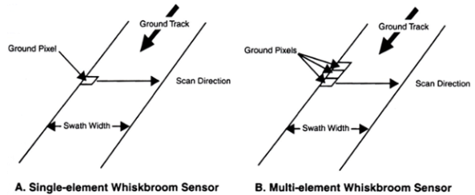
Sensor Scanning Techniques (1/3)
Fig 9-14
Whiskbroom sensors
single detector element corresponding to a single pixel
scans in crosstrack direction (often by means of a mirror)
along-track scanning accomplished by motion of S/C along groundtrack

Slide 25
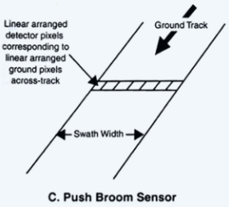
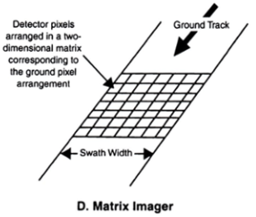
Sensor Scanning Techniques (2/3)
Fig 9-14
Pushbroom sensor
linear arrangement of sensors in crosstrack direction
entire swath width read at once
along-track scanning accomplished by motion of S/C along groundtrack
Matrix scanner (aka staring)
can capture entire image or be in segments

Slide 26
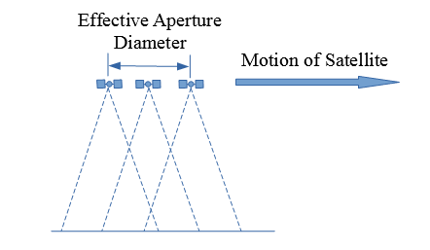
Sensor Scanning Techniques (3/3)
Synthetic aperture radar (SAR)
active sensor (s/c emits radar and collects the return)

Slide 27
Characterizing Remote Sensing Information

Slide 28
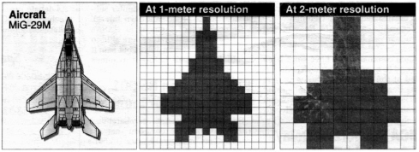
Spatial Resolution
Smallest physical features that can be discriminated
Image from Designing Space Missions and Systems, Presentation Slide 32

Slide 29
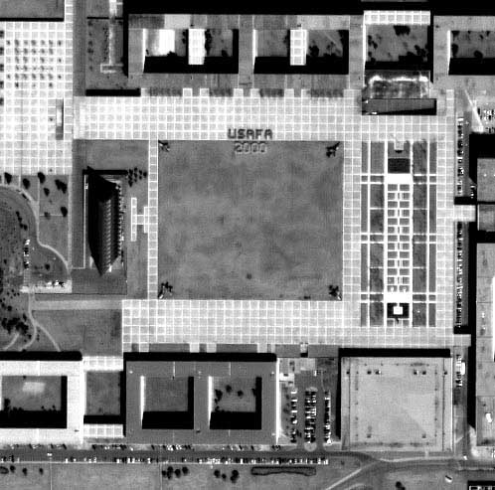

Slide 30
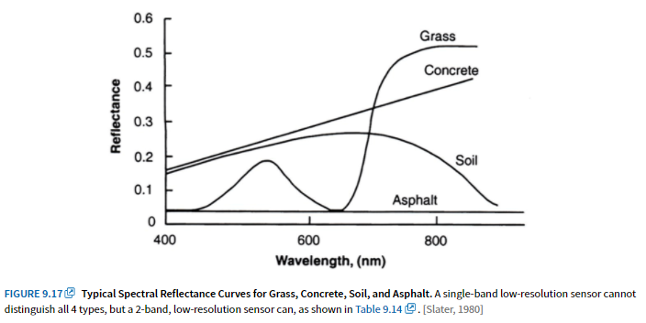
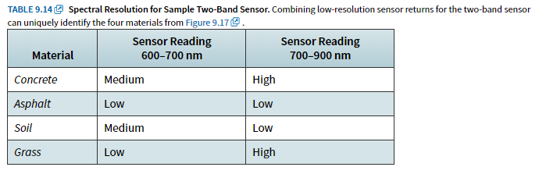
Spectral Resolution
Use spectral content of scene to identify chemical composition

Slide 31
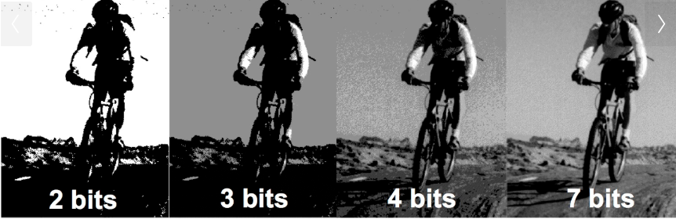
Radiance Resolution
Radiometric info (intensity): total amount of radiant energy
impacted by number of quantization levels
Image from Designing Space Missions and Systems, Presentation Slide 24

Slide 32
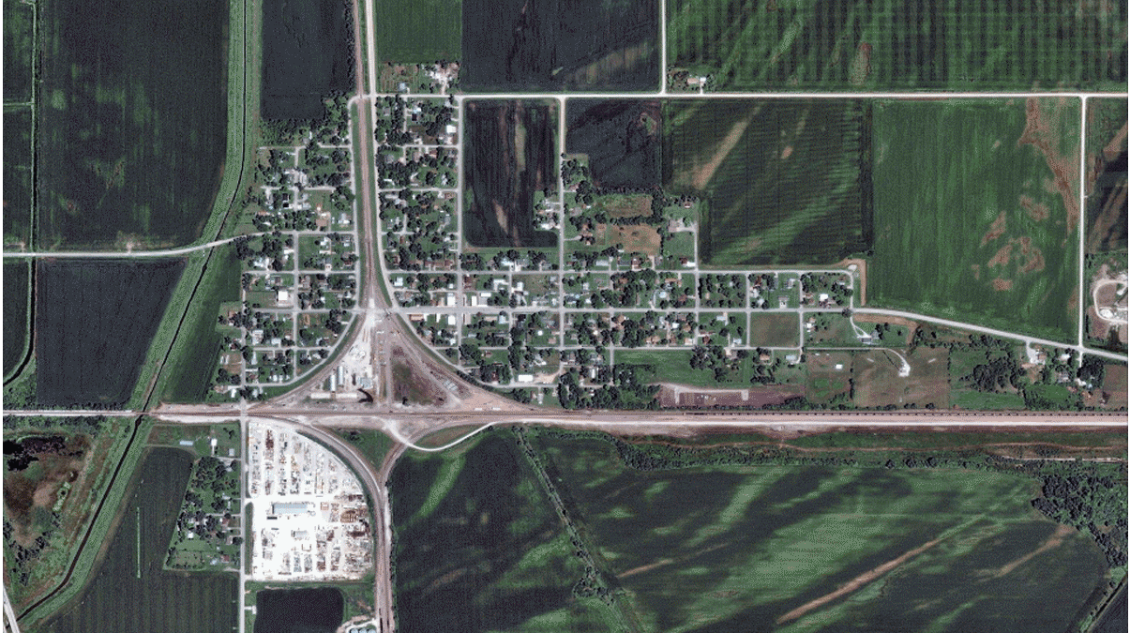
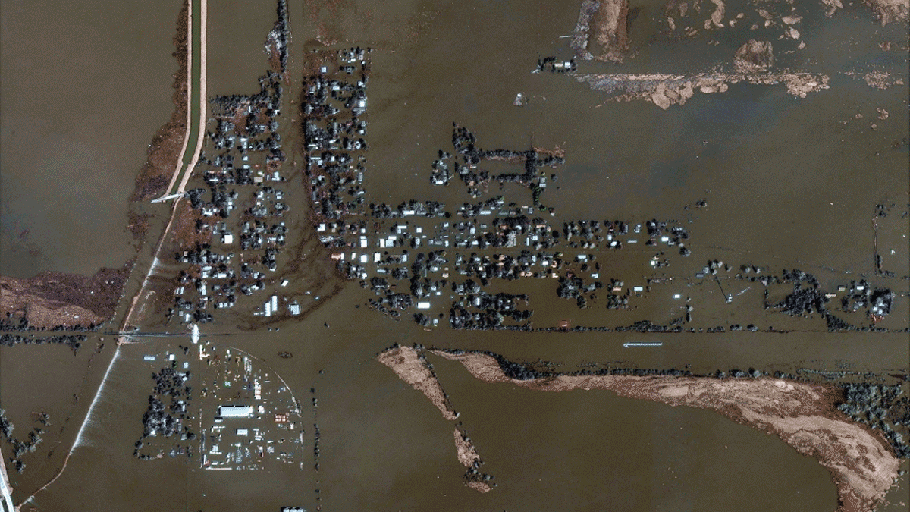
Temporal Resolution
time-changing characteristics (for comparison)
Digital Globe images of Pacific Junction, Iowa (Mar 2019)

Slide 33
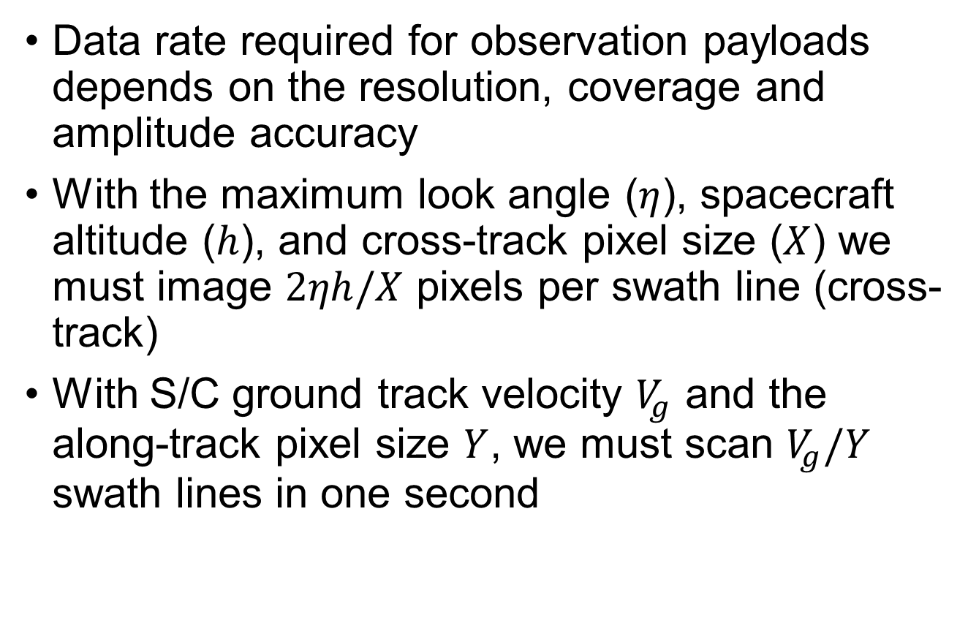
Data Rate (1/2)
Data rate required for observation payloads depends on the resolution, coverage and amplitude accuracy
With the maximum look angle ($η$), spacecraft altitude ($h$), and cross-track pixel size ($X$) we must image $2ηh/X$ pixels per swath line (cross-track)
With S/C ground track velocity $V_{g}$ and the along-track pixel size $Y$, we must scan $V_{g}/Y$ swath lines in one second

Slide 34
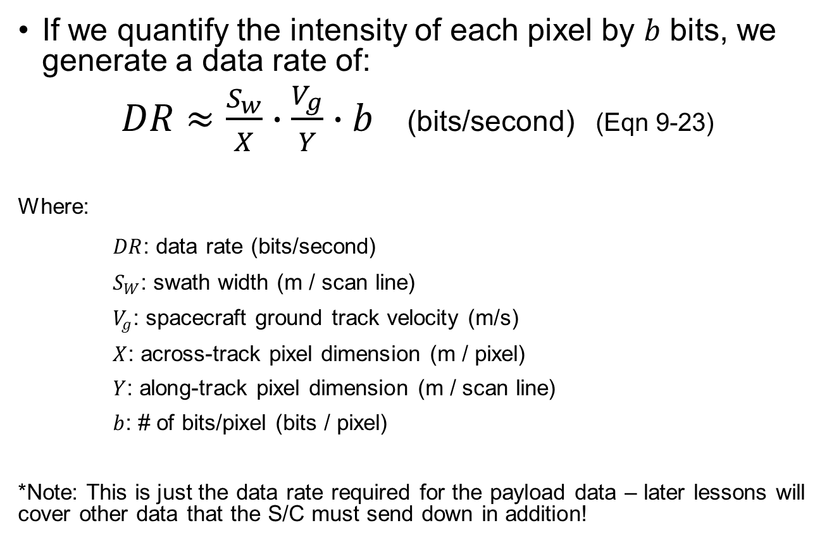
Data Rate (2/2)
If we quantify the intensity of each pixel by $b$ bits, we generate a data rate of:
$DR≈\frac{S_{w}}{X}∙\frac{V_{g}}{Y}∙b$ (bits/second) (Eqn 9-23)
Where:
$DR$: data rate (bits/second)
$S_{W}$: swath width (m / scan line)
$V_{g}$: spacecraft ground track velocity (m/s)
$X$: across-track pixel dimension (m / pixel)
$Y$: along-track pixel dimension (m / scan line)
$b$: # of bits/pixel (bits / pixel)
*Note: This is just the data rate required for the payload data – later lessons will cover other data that the S/C must send down in addition!

Slide 35
Data Rate Example (1/2)
Calculate the data rate needed for a payload with the following characteristics.
Mission characteristics:
Swath width: 50 km
Circular orbit
Altitude: 500 km
Payload characteristics:
Image detector size: 2048 x 2048 pixels
8-bit per pixel resolution

Slide 36
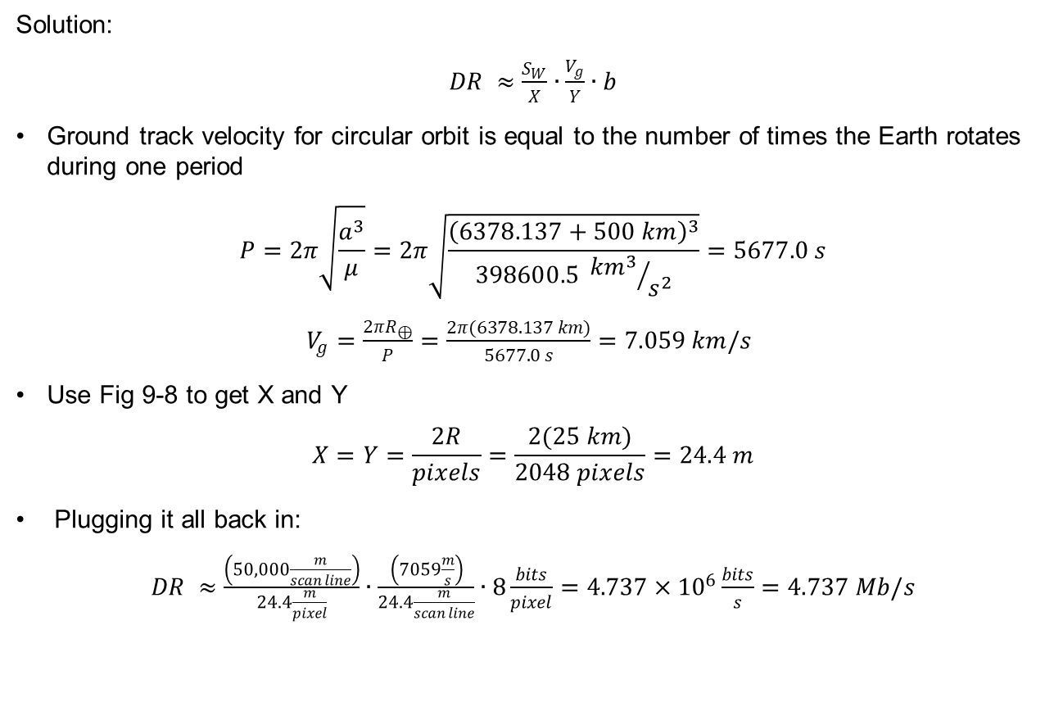
Data Rate Example (2/2)
Solution:
$DR ≈\frac{S_{W}}{X}∙\frac{V_{g}}{Y}∙b$
Ground track velocity for circular orbit is equal to the number of times the Earth rotates during one period
$$P=2π\sqrt{\frac{a^{3}}{μ}}=2π\sqrt{\frac{{\left(6378.137+500 km\right)}^{3}}{398600.5 {{km}^{3}}/{s^{2}}}}=5677.0 s$$
$V_{g}=\frac{2πR_{⊕}}{P}=\frac{2π(6378.137 km)}{5677.0 s}=7.059 km/s$
Use Fig 9-8 to get X and Y
$$X=Y=\frac{2R}{pixels}=\frac{2(25 km)}{2048 pixels}=24.4 m$$
Plugging it all back in:
$DR ≈\frac{\left(50,000\frac{m}{scan line}\right)}{24.4\frac{m}{pixel}}∙\frac{\left(7059\frac{m}{s}\right)}{24.4\frac{m}{scan line}}∙8\frac{bits}{pixel}=4.737×{10}^{6}\frac{bits}{s}=4.737 Mb/s$

Slide 37
Spacecraft Design Budgets
Budgets: allocations of finite resources or consumables
Types:
Power
Mass (weight)
Propellant
Reliability (more to come on this later)

Slide 38
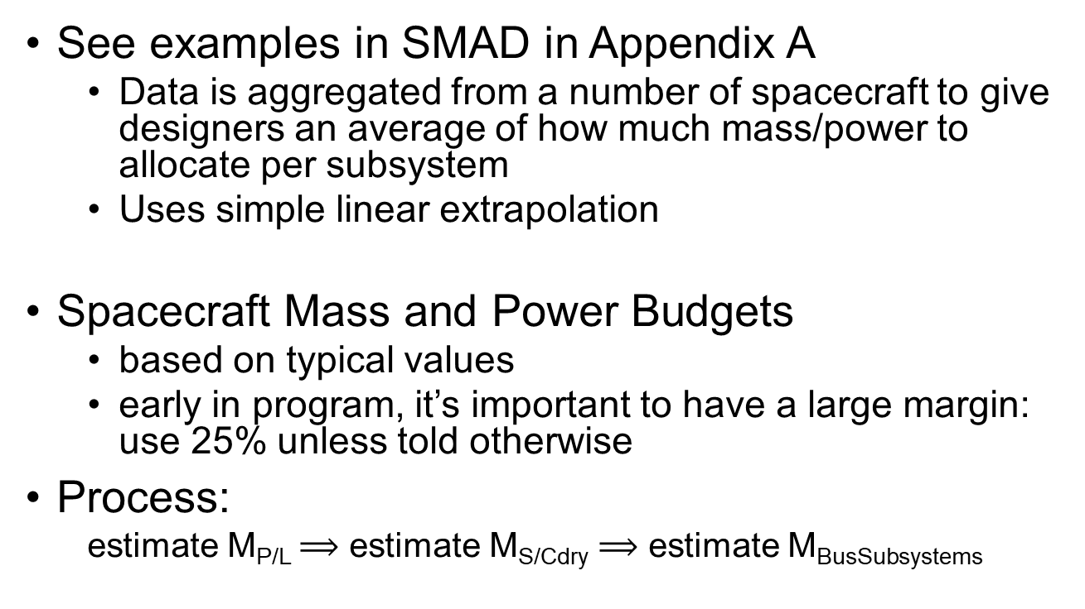
Mass & Power Budgets
See examples in SMAD in Appendix A
Data is aggregated from a number of spacecraft to give designers an average of how much mass/power to allocate per subsystem
Uses simple linear extrapolation
Spacecraft Mass and Power Budgets
based on typical values
early in program, it’s important to have a large margin: use 25% unless told otherwise
Process:
estimate M_{P/L} $⟹$ estimate M_{S/Cdry} $⟹$ estimate M_{BusSubsystems}

Slide 39
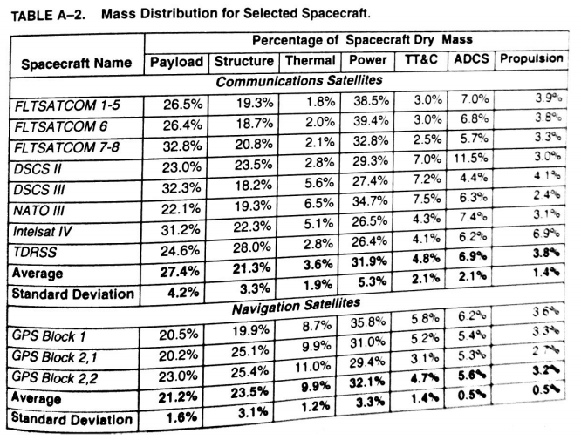
Mass Estimates
*Notes:
Not all columns add to exactly 100%, as they are averages (that’s okay)
There is another table with other types of satellites in the SMAD Appendices

Slide 40
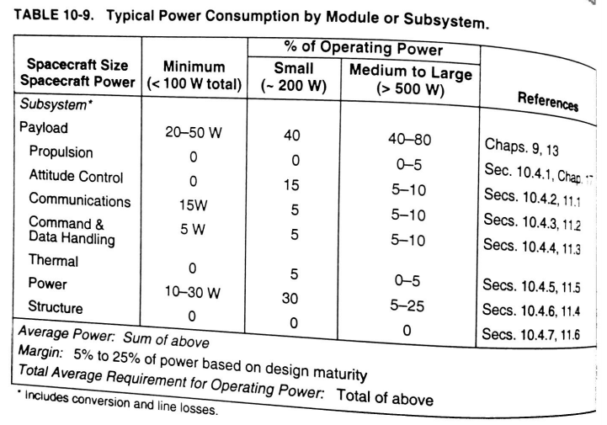
Power Estimates
*Notes:
- Pick low end of payload percentage to be conservative
Combine Comm and C&DH to get TT&C (to be consistent w/ mass estimates)
Can choose any combination of percentages in row, as long as the total sums to 100%

Slide 41
S/C Budget Example (1/2)
Given: Communications satellite w/ payload mass of 250 kg and payload power of 350 W
Find: Estimates of S/C dry mass w/ margin and S/C power w/ margin

Slide 42
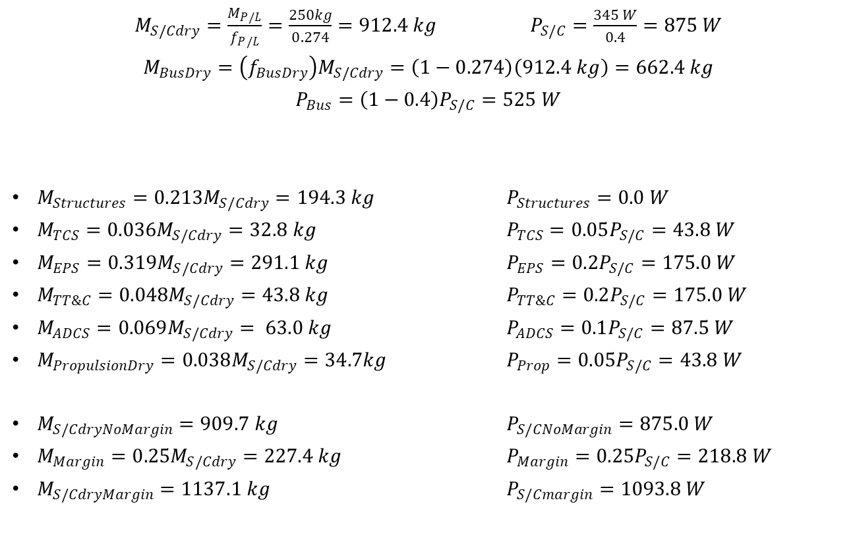
S/C Budget Example (2/2)
$M_{S/Cdry}=\frac{M_{P/L}}{f_{P/L}}=\frac{250kg}{0.274}=912.4 kg$ $P_{S/C}=\frac{345 W}{0.4}=875 W$
$$M_{BusDry}=\left(f_{BusDry}\right)M_{S/Cdry}=\left(1−0.274\right)\left(912.4 kg\right)=662.4 kg$$
$$P_{Bus}=\left(1−0.4\right)P_{S/C}=525 W$$
$M_{Structures}=0.213M_{S/Cdry}=194.3 kg$ $P_{Structures}=0.0 W$
$M_{TCS}=0.036M_{S/Cdry}=32.8 kg$ $P_{TCS}=0.05P_{S/C}=43.8 W$
$M_{EPS}=0.319M_{S/Cdry}=291.1 kg$ $P_{EPS}=0.2P_{S/C}=175.0 W$
$M_{TT\&C}=0.048M_{S/Cdry}=43.8 kg$ $P_{TT\&C}=0.2P_{S/C}=175.0 W$
$M_{ADCS}=0.069M_{S/Cdry}= 63.0 kg$ $P_{ADCS}=0.1P_{S/C}=87.5 W$
$M_{PropulsionDry}=0.038M_{S/Cdry}=34.7kg$ $P_{Prop}=0.05P_{S/C}=43.8 W$
$M_{S/CdryNoMargin}=909.7 kg$ $P_{S/CNoMargin}=875.0 W$
$M_{Margin}=0.25M_{S/Cdry}=227.4 kg$ $P_{Margin}=0.25P_{S/C}=218.8 W$
$M_{S/CdryMargin}=1137.1 kg$ $P_{S/Cmargin}=1093.8 W$

